Slide 1
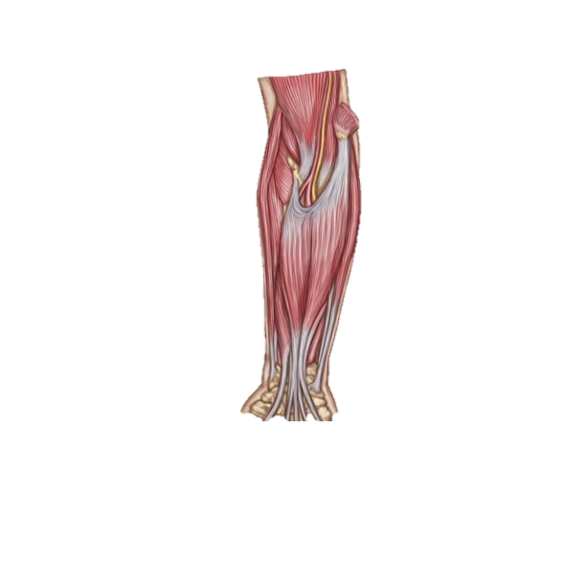
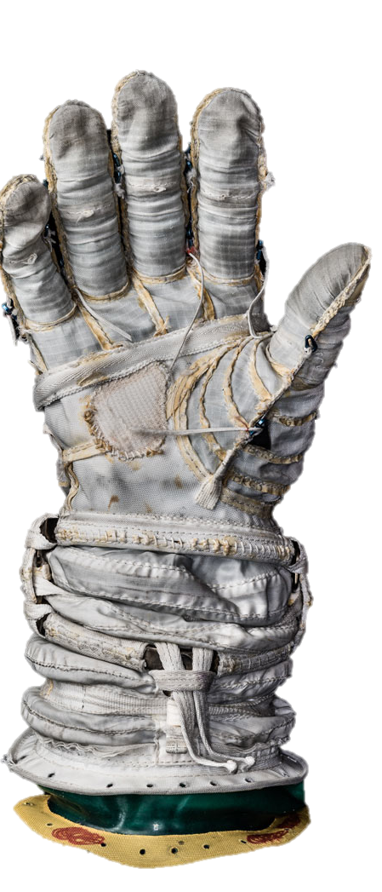

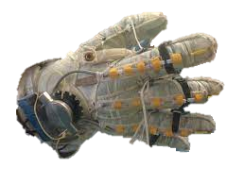
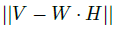
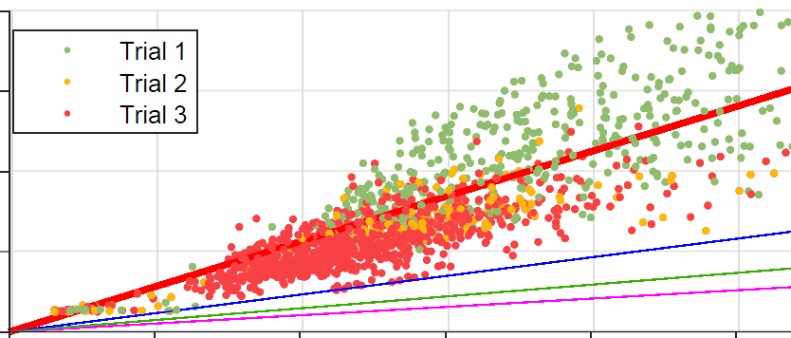
GOAL:
Prior Work:
Pending Steps:
sEMG-based fatigue estimation for exoskeleton control
Novel fatigue estimation algorithm developed and validated in human trials
Design and fabricate a robotic testbed for control validation
Develop sEMG-based control modes for hand grasp assistance
Instrument and control with sEMG
No Fatigued
Slight Fatigued
Most Fatigue
Target Muscles:
Flexor digitorum superficialis,
Extensor digitorum
e.g. NASA Spacesuit RoboGlove exoskeleton, not EMG controlled

Slide 2
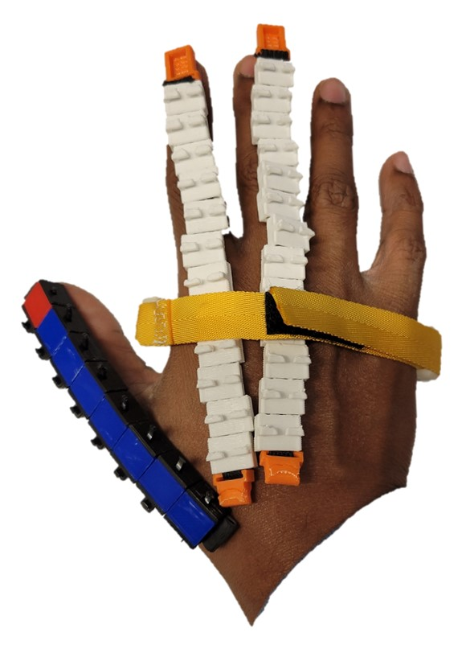
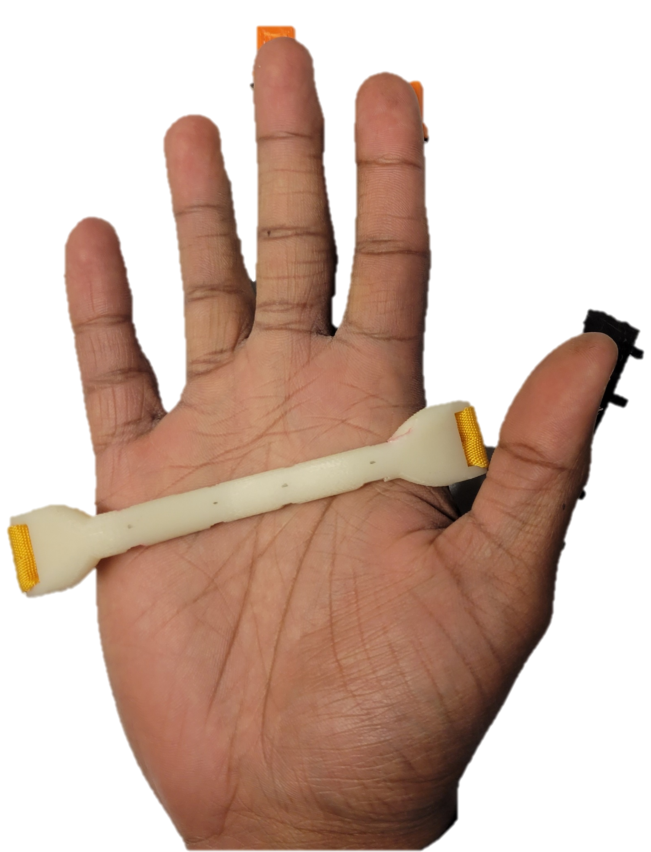
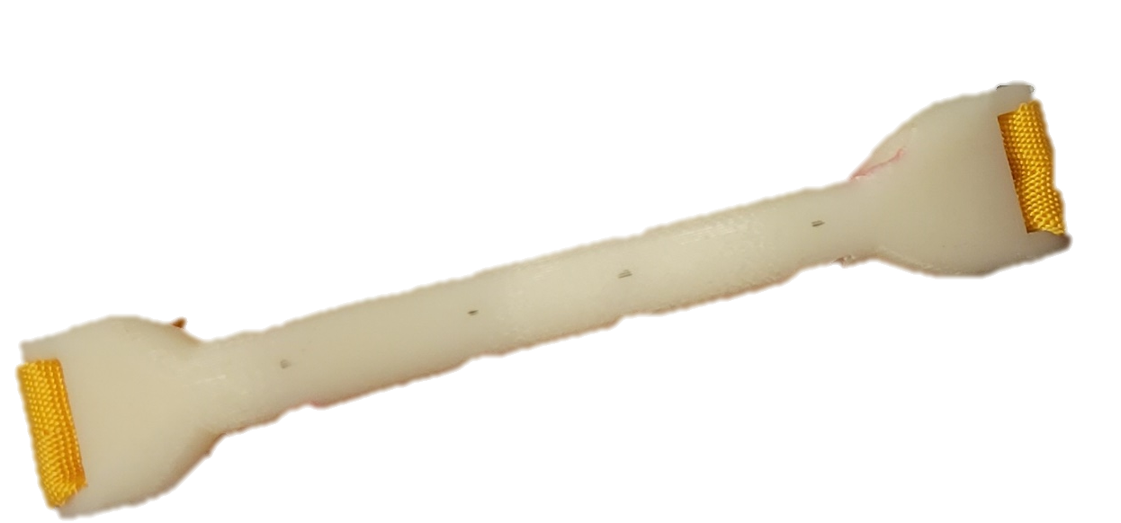
A2.
B2.
Cables
anchored
A1.
C2.
Wrist-mounted
DC Motor 1
Extensor
mount
A1.
B1.
C1.

Slide 3
